Slide 1
Lexical Automatic Machine Translation Evaluation Metric for Indic languages
Submitted in the partial fulfillment for the award of the degree of
BACHELOR OF ENGINEERING
IN
COMPUTER SCIENCE WITH SPECIALIZATION IN ARTIFICIAL INTELLIGENCE AND MACHINE LEARNING
Submitted by:
Divyaprem (20BCS6618)
Lalit Bisht (20BCS6609)
Ankit Ghoshal (20BCS6621)
Ayush Raj (20BCS6612)
Under the Supervision of:
Ms. Shweta Chauhan
Department of AIT-CSE
DISCOVER . LEARN . EMPOWER

Slide 2
Outline
Introduction to Project
Problem Formulation
Objectives of the work
Methodology used
Results and Outputs
Conclusion
Future Scope
References

Slide 3
Introduction to Project
There are various machine translators present in the economy these days such as Google, Yahoo , Bing etc. In order to access the quality of the Machine Translation outputs we use various metrics (parameters) such as BLEU,METEOR,TER,NIST,ROUGE etc. Indic Languages are a group of languages spoken in the Indian Subcontinent , including Hindi, Punjabi , Bengali, Tamil, Telugu, among others. We need to check all the machine translators present in the current market and evaluate them on the basis of the performance on each metric.

Slide 4
Problem Formulation
The need for lexical automatic translation evaluation metrics for Indic languages arises from the fact that Indic languages, such as Hindi, Bengali, Tamil, and others, have a complex morphology and syntax, which makes it challenging to evaluate the quality of machine translations accurately . Machine translation systems for Indic languages often rely on statistical models, rule-based approaches, or neural networks, which generate translations based on the input text. However, the accuracy of these translations varies, and it is challenging to compare them objectively. This is where automatic translation evaluation metrics come into play.
Automatic translation evaluation metrics are algorithms that measure the quality of machine translations by comparing them to human translations. These metrics use various criteria, such as precision, recall, and F1-score, to evaluate the translation's lexical, semantic, and syntactic accuracy. However, existing automatic translation evaluation metrics are primarily designed for English and other Western languages and may not be suitable for Indic languages.Therefore, there is a need to develop automatic translation evaluation metrics that are specific to Indic languages and account for their unique linguistic characteristics. These metrics can help researchers and developers to evaluate the performance of machine translation systems accurately and improve their quality.

Slide 5
Objectives of the Work
To identify and analyze the strengths and weaknesses of different automatic machine translation evaluation metrics that are commonly used for other languages.
To review the unique linguistic characteristics of Indic languages, such as complex grammar and syntax, and to investigate how these characteristics can impact the accuracy of machine translation.
To evaluate the effectiveness of existing metrics for evaluating machine translation quality in Indic languages and to identify which metrics are most suitable for these languages.
To propose new metrics or modifications to existing metrics that can more accurately evaluate machine translation quality in Indic languages.
To conduct experiments using different evaluation metrics to compare the accuracy of machine translation output for Indic languages, and to draw conclusions about the most effective metrics for this purpose.
To create a set of guidelines or recommendations for developers and researchers working on machine translation systems for Indic languages, based on the results of the study.
To contribute to the advancement of natural language processing research and the development of more accurate and reliable machine translation systems for Indic languages.

Slide 6
Methodology used
Literature review: Conduct a thorough review of existing research on machine translation evaluation metrics for Indic languages. This review should include research on automatic evaluation metrics for other languages that could be adapted for Indic languages.
Data collection: Gather a corpus of translated text in Indic languages and their corresponding reference translations. The corpus should be diverse and cover a range of topics and styles.
Metric selection: Select a set of metrics that are commonly used for evaluating machine translation quality in other languages, as well as any metrics specifically designed for Indic languages. This set of metrics should include both lexical metrics (e.g., BLEU, METEOR) and semantic metrics (e.g., ROUGE, TER).
Data analysis: Analyze the data collected from the experiment to determine the effectiveness of each metric in evaluating machine translation quality in Indic languages.
Metric modification: Based on the results of the experiment, modify or propose new metrics that more accurately evaluate machine translation quality in Indic languages.
Guideline development: Develop a set of guidelines or recommendations for developers and researchers working on machine translation systems for Indic languages, based on the results of the study.

Slide 7
Results and Outputs
BLEU:Bilingual Evaluation Understudy (BLEU) BLEU [20] is still considered the most reliable metric and it is used extensively in the MT community to evaluate the translation quality. The translation output may change with respect to the word choice or word order. This is easily distinguishable by humans but is difcult for machines. Evaluating the translation is also a difcult task without the help of human translators. It is calculated by comparison of n-grams of the MT output with the n-grams of the reference translation and then counting the number of matches.

Slide 8
NIST(National Institute of Standards and Technology):The NIST metric is based on the BLEU evaluation metric but difers in some ways . Instead of n-gram precision, the information gained from each n-gram is considered, implying that the NIST metric determines the importance of each n-gram in relation to the phrase. The importance of each n-gram is obtained with the help of weights. A correct n-gram will be given high weightage if it is quite less likely to occur or rare. The length penalty known as brevity penalty for the NIST score is calculated such that small variations in the length of translation sentences do not afect the overall score signifcantly.
Recall Oriented Understudy for the Gisting Evaluation (ROUGE):It is a set of measures for evaluating automated text summarization and MT. ROUGE evaluates the MT output with respect to a reference sentence. The evaluation is based on a number of factors, including the number of overlapping units like n-grams, word sequences, and word pairs between the computer-generated summary and the refer based summaries

Slide 9
Translation Error Rate (TER):TER is an evaluation measure score that uses the edit distance to improve the lexical matching process. The edit distance is the number of adjustments that must be made to the translation sentence for it to match the reference sentence exactly. Insertion, deletion, the substitution of single words, and shifts of neighboring sequences of words are all possible in TER. All allowed edits have equal weightage. The number of edits required is calculated using dynamic programming that is used to determine edit distance based on the number of insertions, deletions, and replacements.

Slide 10
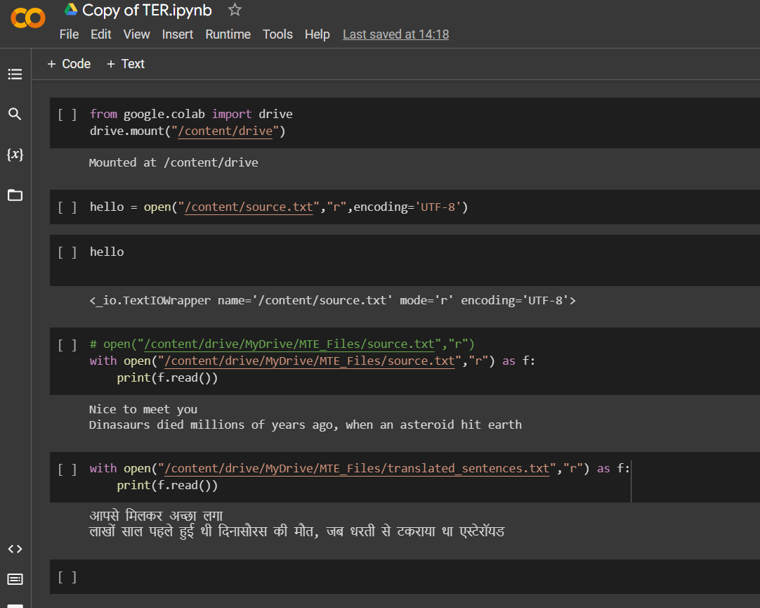

Slide 11
Conclusion
Fully automatic MT evaluation measures are meant to be more objective, faster, and less expensive than human evaluation. The usage of this sort of evaluation has grown in popularity over the last few decades among MT developers since it allows them to conduct quick automatic evaluations of their MT models and use the results to improve them in the right direction. Fully AMTE metrics provide a comparison of the MT output to the reference translation. If the quality of reference sentences is good and multiple references have been provided, then most of the fully AMTE metrics will evaluate MT model translated sentences better

Slide 12
Future Scope
There is still need a for robust automatic evaluation metrics, but developing such metrics is a challenging task due to a wide variety of criteria. To build a standard code or a common platform where new evaluation metrics results can be compared with existing evaluation metrics that will help to critically examine the new evaluation metrics. Low cost, tunable, consistent, meaningful, correct, and robust for diferent languages such as Indic ones are other challenges faced in fully AMTE metrics. These metrics will be enhanced over a time period.

Slide 13
References
Zhou M, Wang B, Liu S, Li M, Zhang D, Zhao T (2008) Diagnostic evaluation of machine translation systems using automatically constructed linguistic check-points. In: Proceedings of the 22nd international conference on computational linguistics (Coling 2008), Manchester, United Kingdom, pp 1121–1128
Han L (2016) Machine translation evaluation resources and methods: a survey. arXiv:1605.04515v8. Cornell University Library
Chatzikoumi E (2020) How to evaluate machine translation: a review of automated and human metrics. Nat Lang Eng 26(2):137–161 9. Sai AB, Mohankumar AK, Khapra MM

